Slide 1
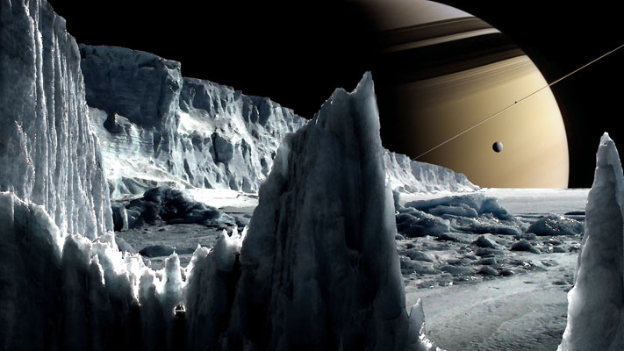
Predicting Life on Enceladus
Alexa Drew
Dr. Sara Imari Walker, John F. Malloy, Dr. Harrison B. Smith
Arizona State University

Slide 2
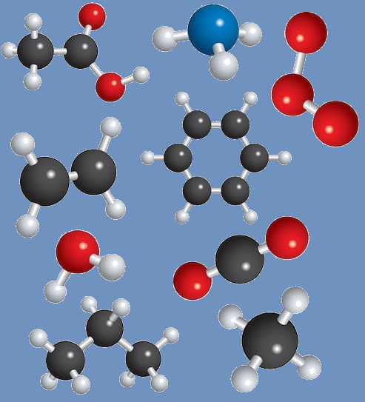
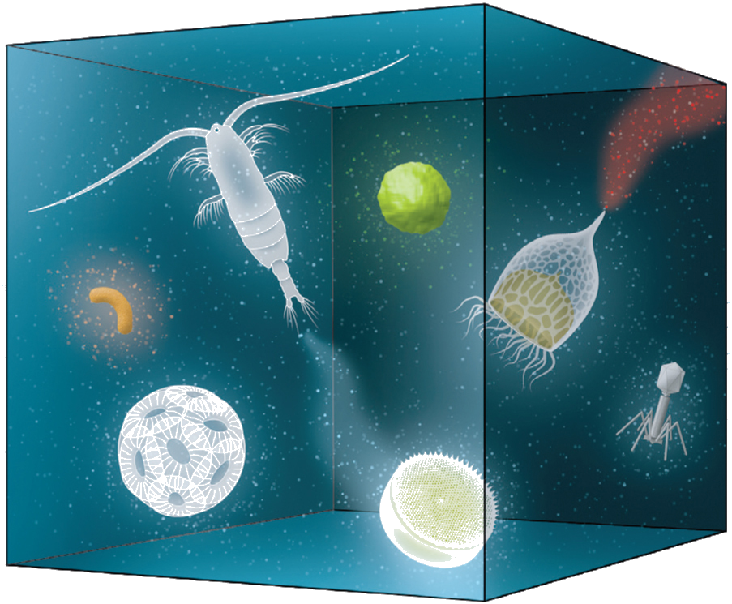
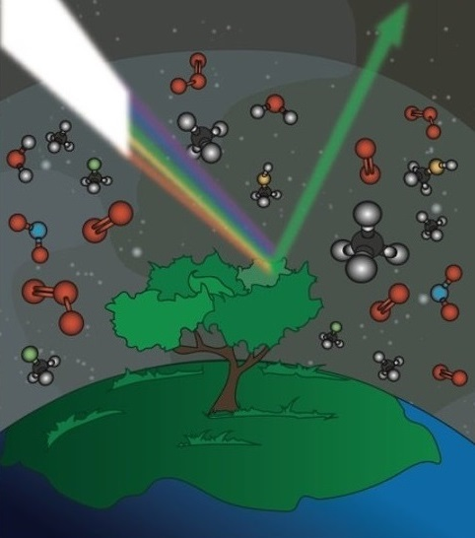
Introduction - Goals
Question: What is the probability of Earth-like life being viable on Enceladus?
Explore chemical
compound importance
Predict life forms using
known conditions
Utilize tailored biosignatures

Slide 3
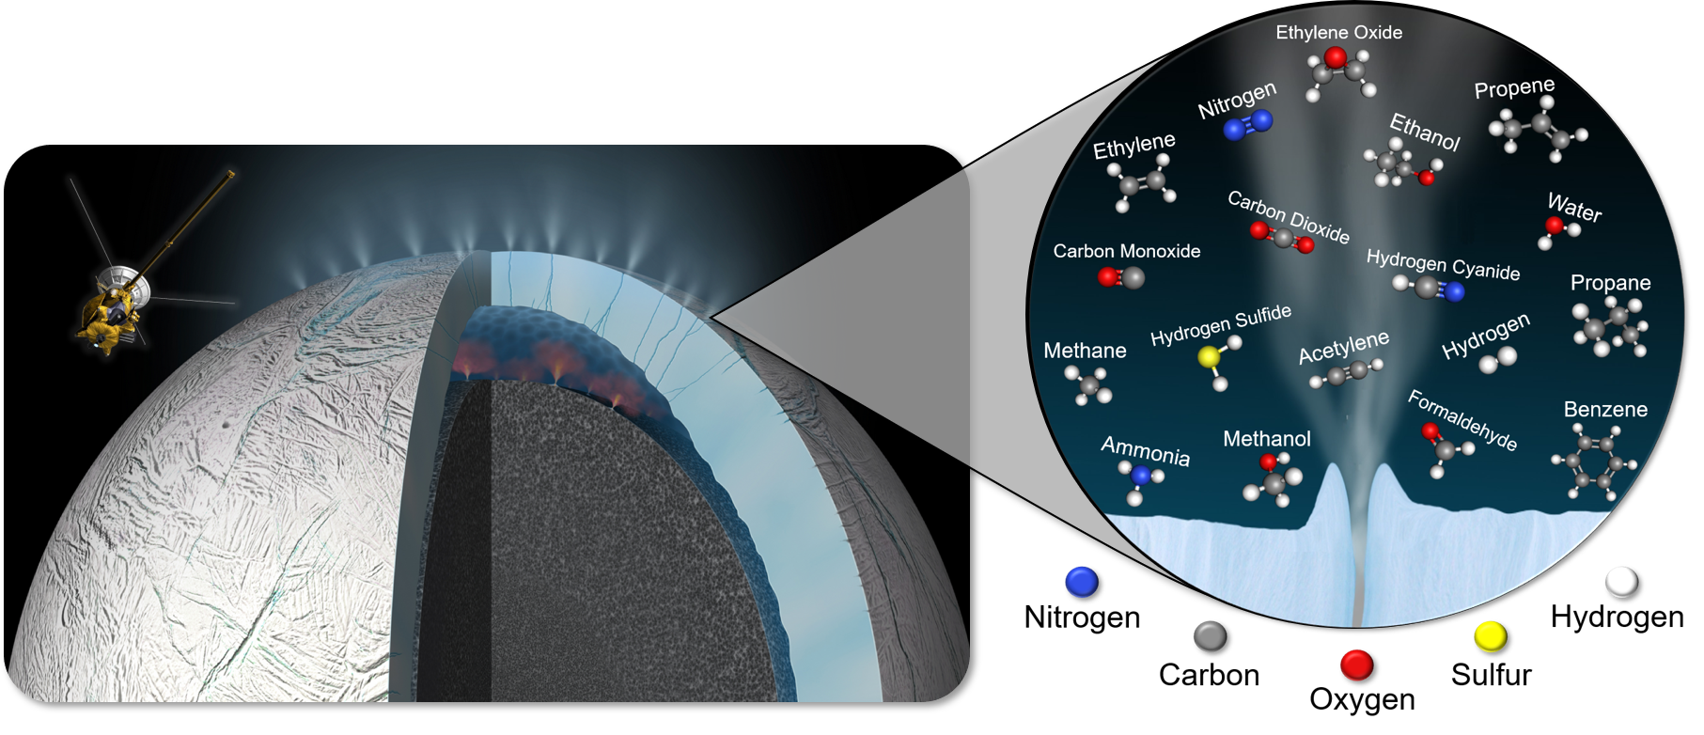
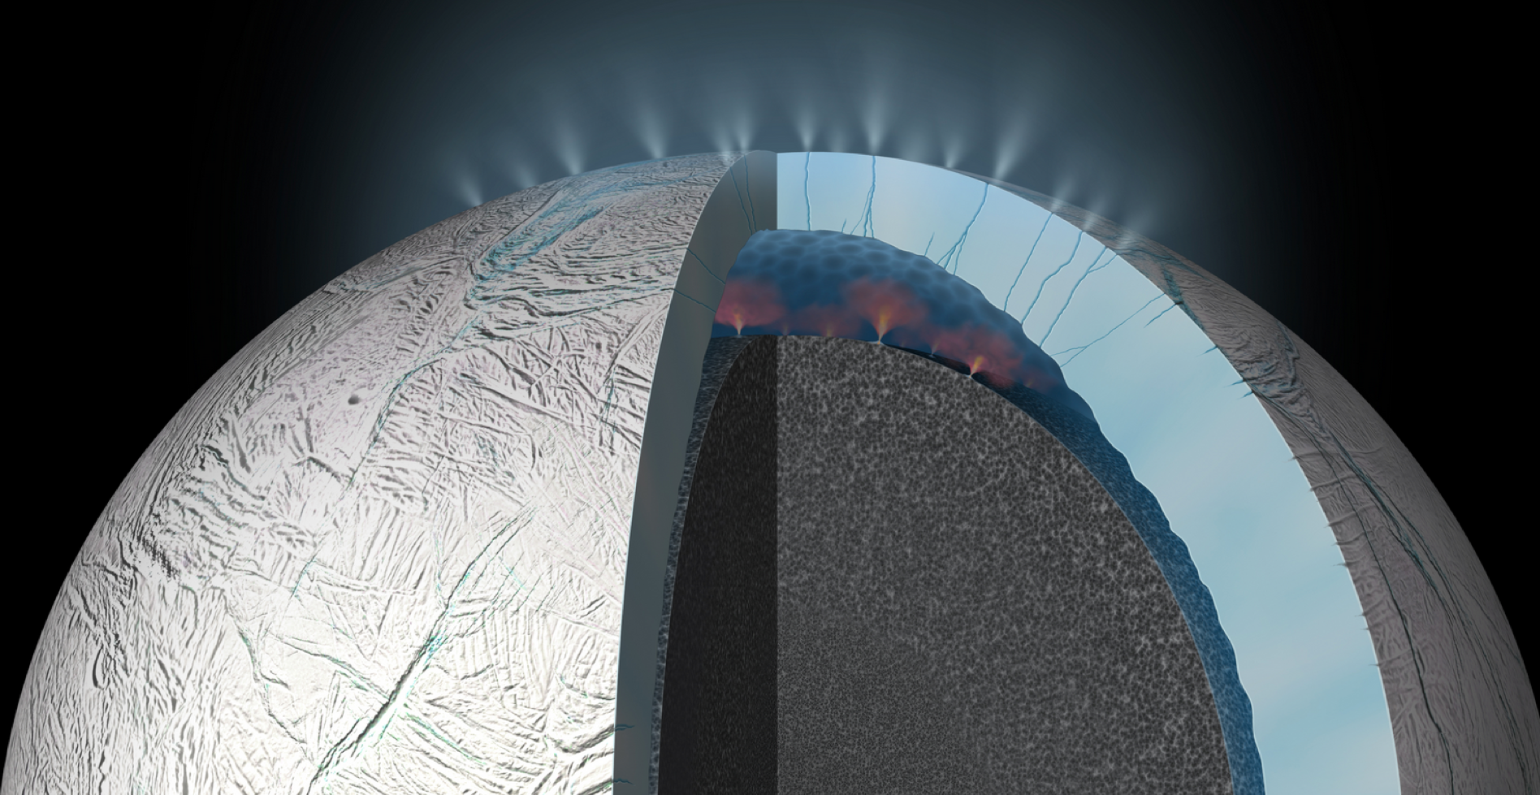
Background – Enceladus
Conditions
High reflectivity, surface temperatures of -201ºC, internal heating via radioactive decay, subsurface ocean, and geysers
Cassini found organic material on Saturn’s 6th largest moon, Enceladus

Slide 4
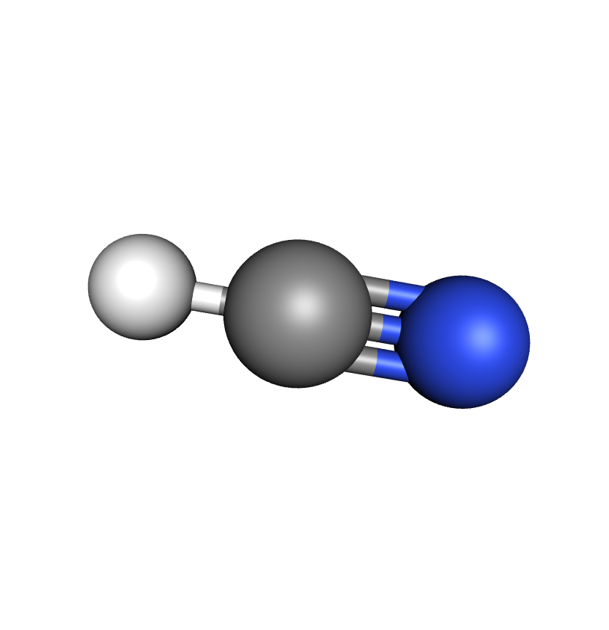


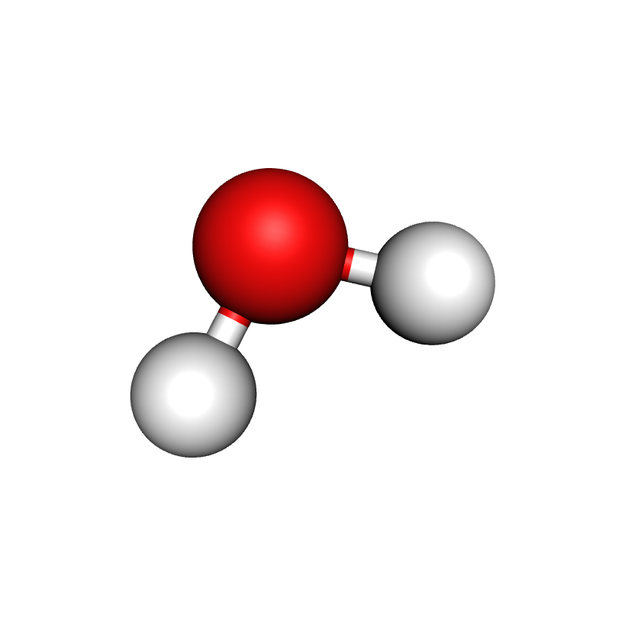

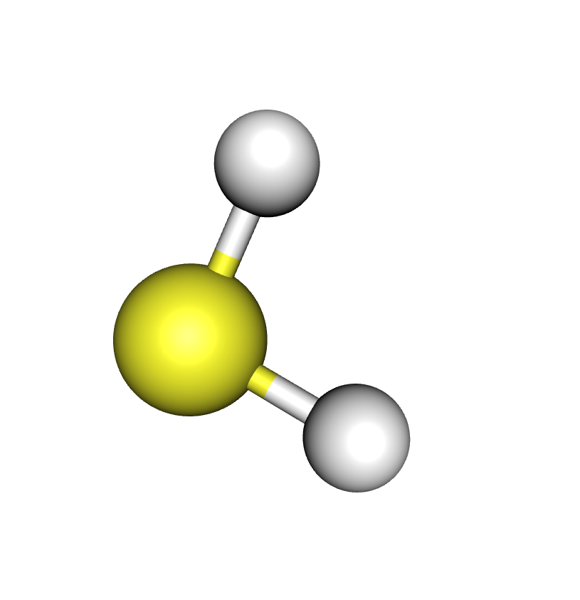

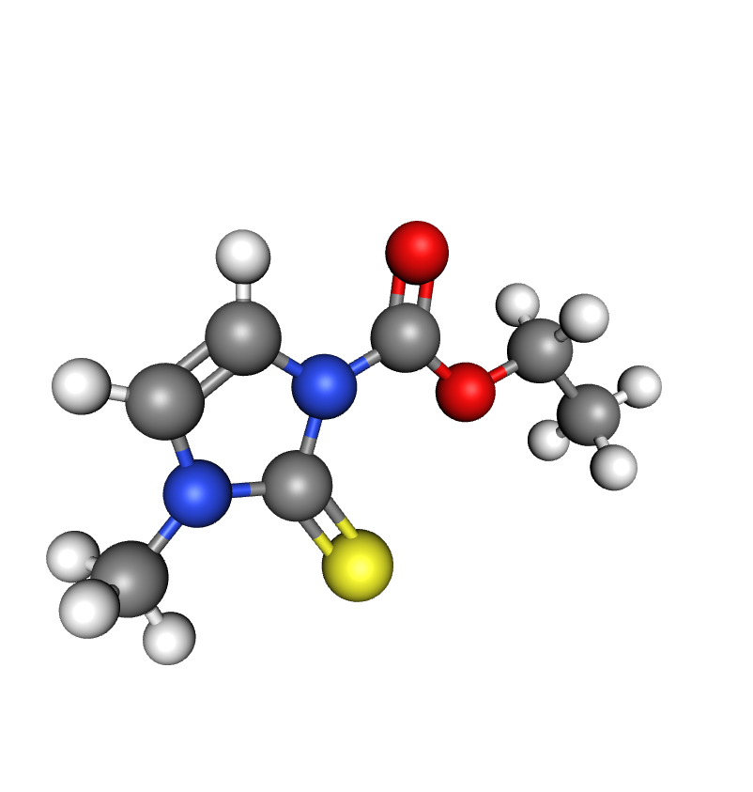


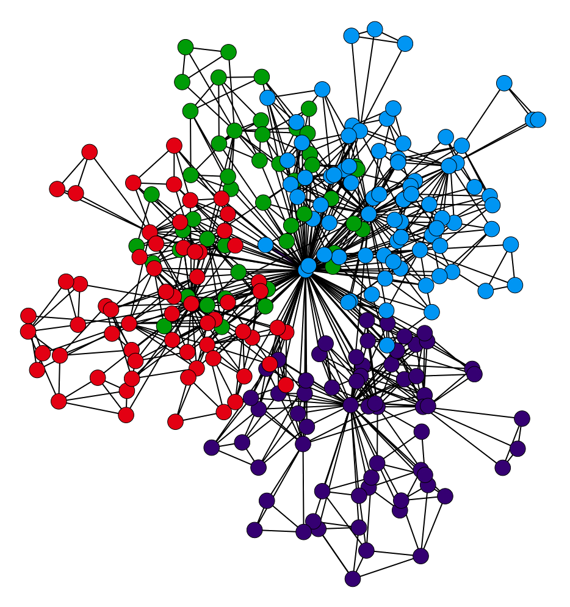
Background – Networks
What’s a network? A system of interconnected items in which simple building blocks react to form increasingly complex units until nothing new can be created
Seeds
Chemical
Reactions
2H + O → H₂O
Complex
Compounds
Network

Slide 5
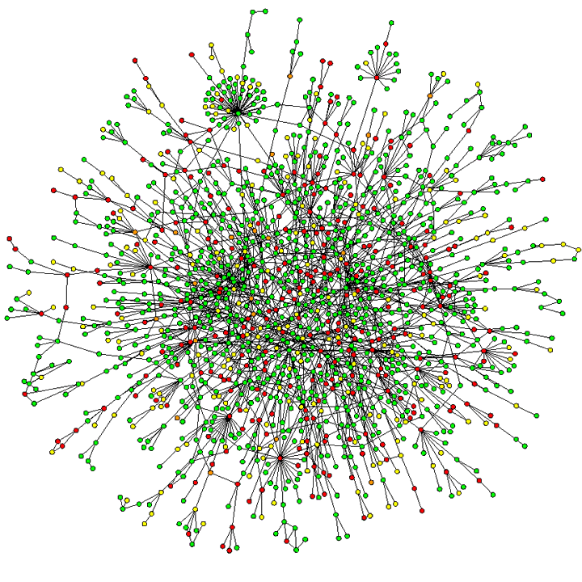
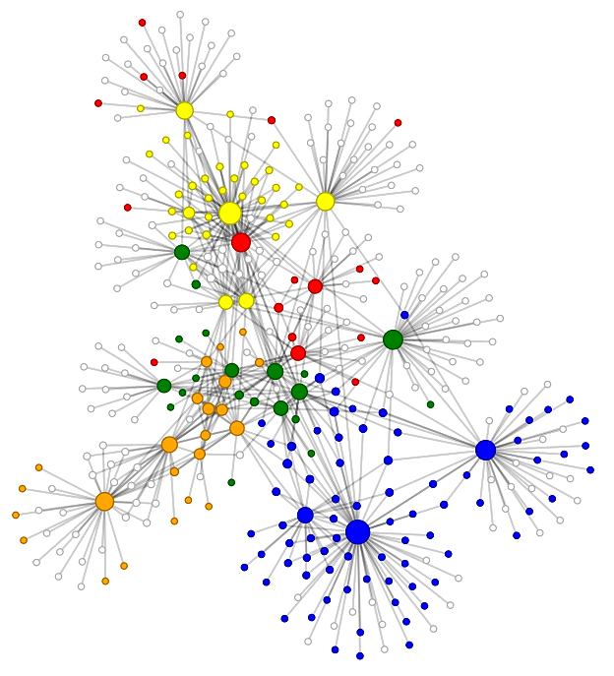
Background – Networks Cont.
What can a network do? Aid in understanding and predicting complex relationships
How can it specifically help here? Tells us what compounds might be created from the seeds reacting on Enceladus, and thus whether Earth-like life might be able to exist there

Slide 6
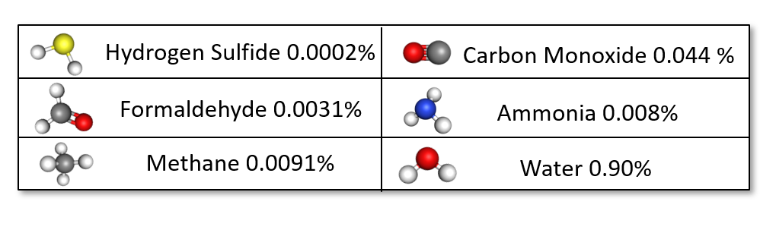
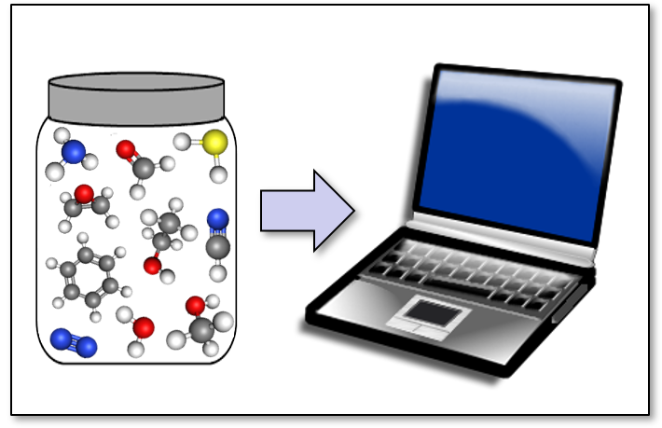
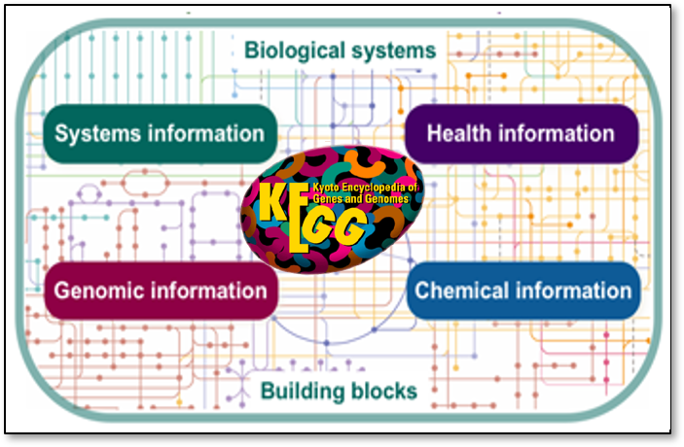





Methods – Building a Network
Compile Compounds/Seeds
5
5
All
10
10
Random Sampling
Create Seed Sets
KEGG Database
Generate Networks!

Slide 7
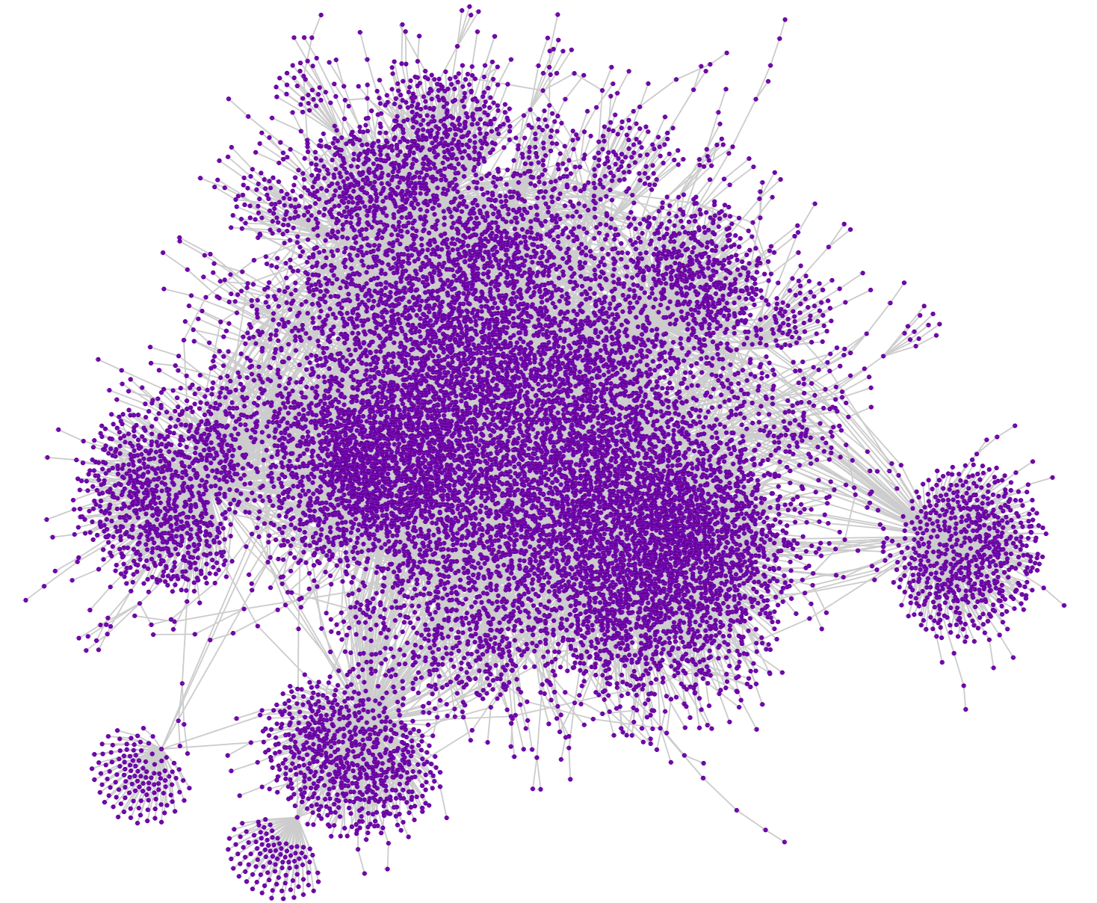

Results – Fully Expanded Network
Fully Expanded Network
Made from gold standard seed set (all seeds react)
In 45 reactions, over 4000 complex compounds needed by life were made
Most complex network possible
Best possible scenario for life

Slide 8
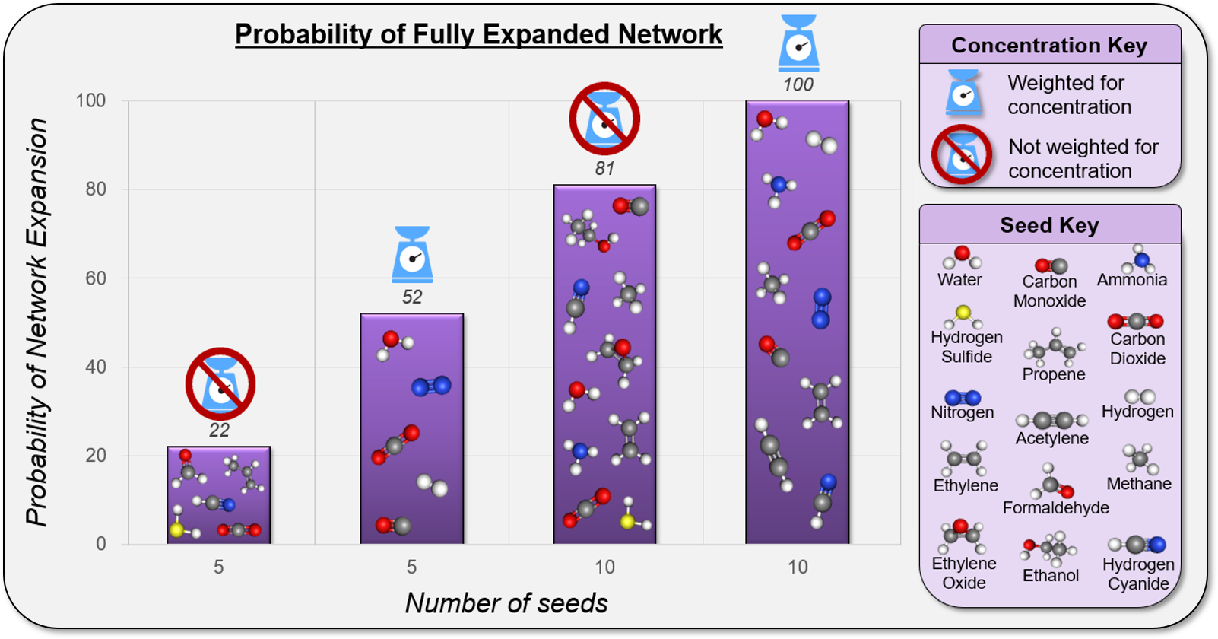
Results – Network Comparison
Seed Sets
A seed set affects the size of a network and its probability of fully expanding
Higher probabilities indicate a higher viability for life
Some seeds must be more significant
Averaged from 100
networks per seed set

Slide 9
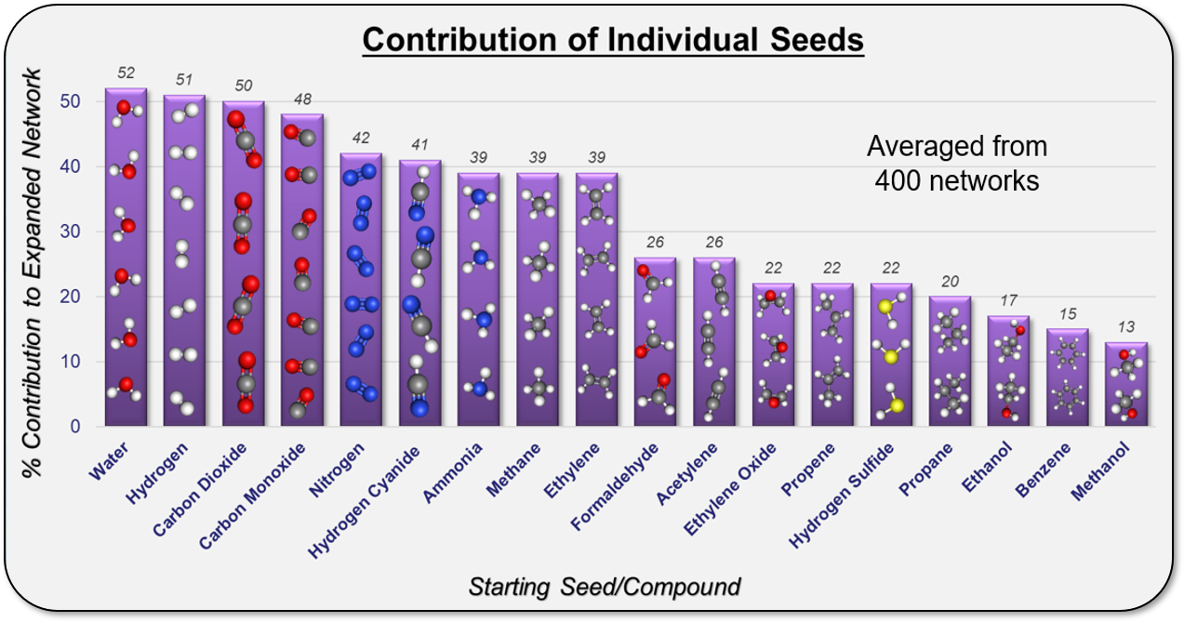
Results – Seed Contributions
Individual Seeds
Some seeds involved in fully expanded networks more often
These seeds contribute more to life’s viability
H₂O’s most important, but not always significant
H₂S’s relative lack of importance noteworthy

Slide 10
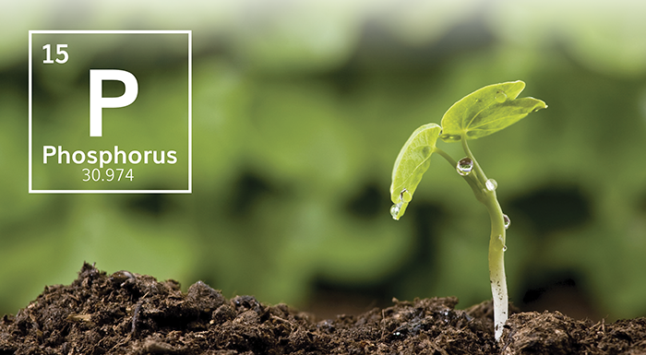
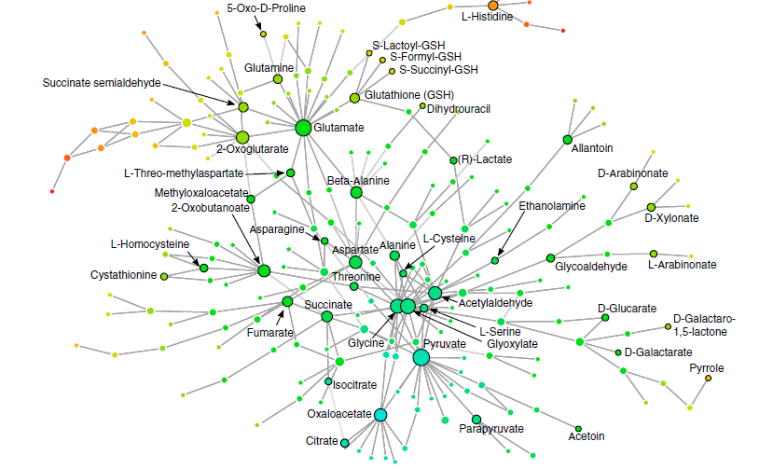
Conclusion – Highlights and Next Steps
Major Highlights: Seeds important for life have high abundance on Enceladus, and thus the chances of Earth-like life viability is possible. How can we increase the odds of viability?
Determine what seeds are missing that more sensitive instruments might find
Explore complex chemical compound importance to develop biosignatures

Slide 11

Acknowledgements – Thank you!
Dr. Sara Imari Walker
John F. Malloy
Dr. Harrison B. Smith
Emergence Lab
Desiree Crawl
Dr. Thomas Sharp
ASU NASA Space Grant
Matt Camargo

Slide 12

Thank You

Slide 13
References and Resources
1 – All chemical compounds, molecules, and seeds made with MolView at molview.org
2 – KEGG: Krypto Encyclopedia of Genes and Genomes at https://www.genome.jp/kegg/
3 – Networks made using Cytoscape program at https://cytoscape.org/
4 – Waite et. al, (2009). Liquid water on Enceladus from observations of ammonia and 40Ar in the plume. Nature, 460(7254), pp.487-490.
5 – Barabasi, A. and Pasfai, M. (2016). Network science. Cambridge: Cambridge University Press.
6 – Smith, H., Drew, A., and Walker, S. (2019). Assessing the Viability of Biochemical Networks on Other Planets. (Pending Publish)
7 – Goldford, J., Hartman, H., Smith, T. and Segrè, D. (2017). Remnants of an Ancient Metabolism without Phosphate. Cell, 168(6), pp.1126-1134.e9.

Slide 14
Image Links
1 – https://www.davidreneke.com/wp-content/uploads/2015/09/enceladus.jpg
2 – http://science.sciencemag.org/content/sci/357/6352/646/F1.large.jpg
3 – https://3c1703fe8d.site.internapcdn.net/newman/gfx/news/hires/2018/34-scientistsde.jpg
4 – http://www.kurzweilai.net/images/Enceladus-plumes.png
5 – https://upload.wikimedia.org/wikipedia/commons/thumb/8/85/Cassini_Transparent.png/552px-Cassini_Transparent.png
6 – https://media.gettyimages.com/illustrations/cutaway-diagram-of-enceladus-plumes-illustration-id82111374
7 – http://veryicon.com/icon/128/System/Oxygen/actions%20go%20home.png
8 – https://thumbs.dreamstime.com/t/suburban-house-realistic-vector-illustration-white-background-49478775.jpg
9 – https://image.shutterstock.com/image-vector/european-village-summer-450w-266814368.jpg
10 – http://cliparting.com/wp-content/uploads/2016/11/Cityscape-city-skyline-clipart-4-clip-art-free-image.png
11 – https://clipground.com/images/straight-road-clipart-20.jpg
12 – https://1.bp.blogspot.com/-kbd6On8ZX_Q/UCoP9kRyBaI/AAAAAAAAATI/wd9cth4sWoA/s1600/smallw-rold%2Bnetwork.png
13 – https://pbs.twimg.com/media/C65Nwx8W0AI4vLf.jpg:medium
14 – http://nicolas.kruchten.com/content/wp-content/uploads/2010/11/screenshot_02.png
15 – http://a51.idata.over-blog.com/300x300/3/76/89/83/High-tech/le-millieme-article.png
16 – https://www.genome.jp/kegg/docs/fig/kegg_overview.png
17 – http://www.clker.com/cliparts/h/P/t/v/h/r/kitchen-scale-md.png
18 – https://hi-news.ru/wp-content/uploads/2017/09/pochva-1300x731.jpg
19 – https://www.wired.com/wp-content/uploads/blogs/playbook/wp-content/uploads/2012/10/red-bull-stratos-salute.jpg
20 – http://www.bytehazard.com/art/enceladus.jpg

